Slide 1
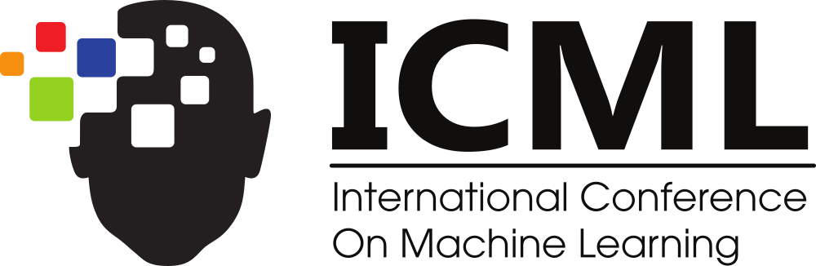

Position: Do pretrained transformers learn in-context by Gradient Descent?
Vienna, 2024
Lingfeng Shen*, Aayush Mishra*, Daniel Khashabi
Notes:
Good evening, everyone! I’m Aayush Mishra, and I am here to present our alternate position to a growing line of work that equates In-Context Learning to Gradient Descent! This is a joint work with my colleagues at Johns Hopkins University.

Slide 2
I have a dream that one day …
LLM
this nation will rise up …
2
Notes:
We know that Language models are trained to predict the next word in natural language sequences, and they do this job quite well.

Slide 3
In-Context Learning (ICL)
Input: JHU Output: Baltimore
Input: IITD Output: Delhi
Input: NYU Output:
LLM
New York
Good evening → Guten Abend
Vienna is great → Wien ist großartig
Where is the next ICML? →
LLM
Wo ist das nächste ICML?
3
Notes:
However, they also exhibit a remarkable property called In-Context Learning or ICL.
Given some examples that exhibit a relationship, a Language Model can understand this relationship and answer queries for new inputs accordingly.
And, LLMs are able to do this for a variety of tasks like translation, sentiment prediction, etc.
##### SCRATCH
The unique thing about this ability is that the model was not trained to perform these tasks explicitly and it achieves this ability directly during inference.

Slide 4
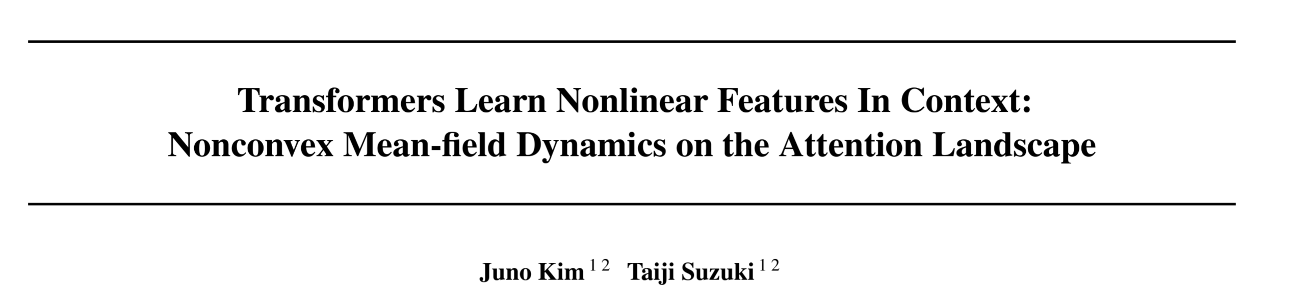
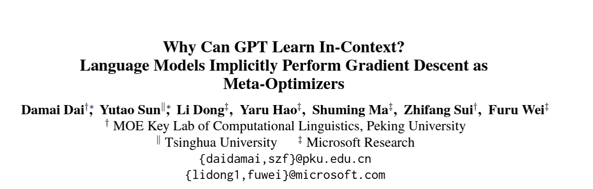
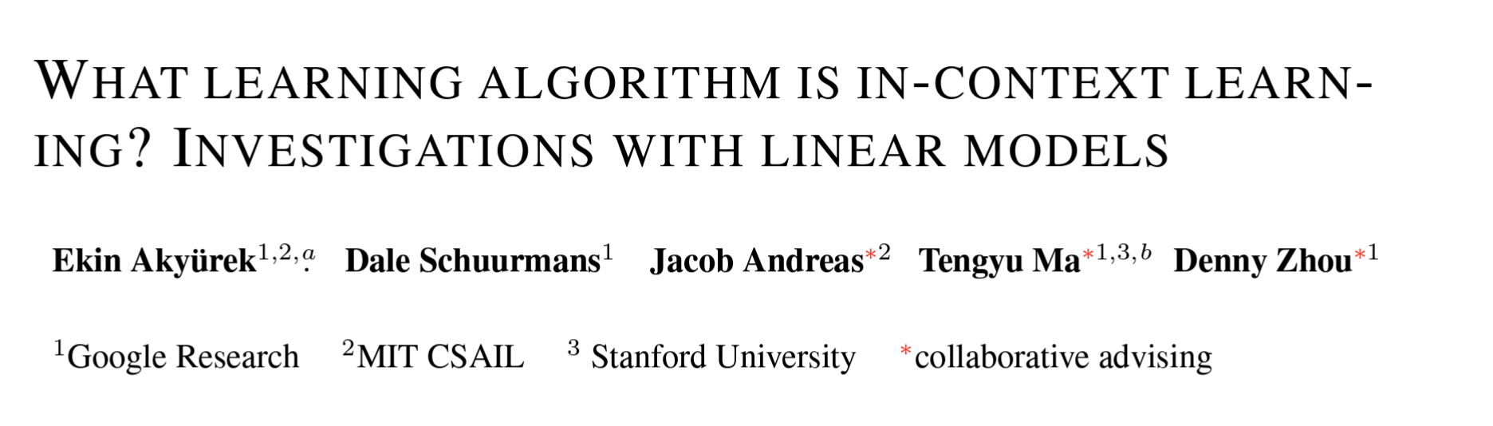


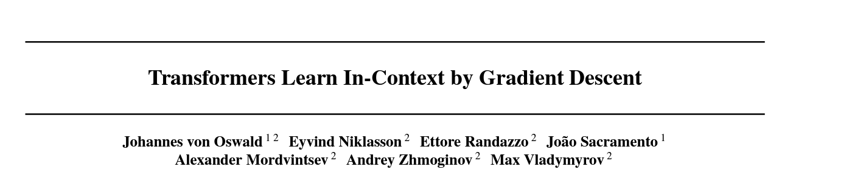
How does In-Context Learning work?
Training
Inference
Gradient Descent
Learnt model
Predict y for new x according to the rule
Learn model
Set of (x, y) pairs
new x
Training + Inference?
In-Context Learning
Predict y for new x according to the rule
LLM
Set of (x, y) pairs
+ new x
Dai, Damai, et al. "Why can gpt learn in-context? language models implicitly perform gradient descent as meta-optimizers." arXiv preprint arXiv:2212.10559 (2022).
Akyürek, Ekin, et al. "What learning algorithm is in-context learning? investigations with linear models." arXiv preprint arXiv:2211.15661 (2022).
Von Oswald, Johannes, et al. "Transformers learn in-context by gradient descent." International Conference on Machine Learning. PMLR, 2023.
Kim, Juno, and Taiji Suzuki. "Transformers learn nonlinear features in context: Nonconvex mean-field dynamics on the attention landscape." arXiv preprint arXiv:2402.01258 (2024).
4
Notes:
So how does In-Context Learning work?
Traditionally, when we are given a set of (x, y) pairs, we would learn a parameterized model to understand the relationship between them. We update the parameters of this model by performing gradient descent on the error surface until convergence. Once we have the learnt model, we perform inference on the new x according to the rule learnt during training.
In contrast, LLMs take the set of (x, y) pairs as well as the new x, all as a single input, and predict y according to their inferred understanding of the rule. They perform this sort of magical training and inference all during test time, without updating any parameters.
This is In-Context Learning and recently, many papers have suggested an equivalence between ICL and implicit gradient descent inside language models. Even some works at this ICML.

Slide 5
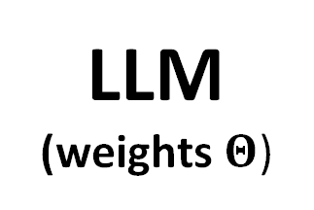
The argument
LLM
(weights $Θ$)
5
Notes:
Their argument is the following:
An LLM with some weights,

Slide 6
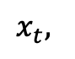
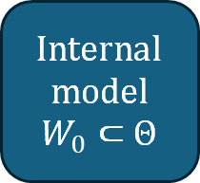
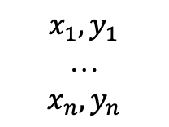
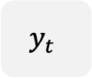
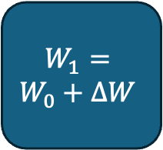
The argument
Internal model
$$W_{0}⊂Θ$$
$$W_{1}=$$
$$W_{0}+ΔW$$
$$x_{1}, y_{1}$$
…
$$x_{n}, y_{n}$$
Update internal model using in-context demos in forward pass
$$y_{t}$$
$$x_{t},$$
Use updated model for inference
6
Notes:
Can be decomposed to reveal a hypothesized internal model.
When some (x, y) pairs are shown in context, the LLM learns to extract training pairs, and uses them to update the internal model with gradient descent “in the forward pass”.
It then uses the updated model to perform inference on this new x.

Slide 7
But here’s the thing …
These theories make oversimplified and sometimes unrealistic assumptions.
The functional nature of ICL (and its equivalence to GD) remains unclear.
7
Notes:
But here’s the thing, the assumptions made in these studies may be oversimplified and unrealistic.
Although these works present interesting hypotheses, our position is that the true functional form of ICL, and its equivalence to traditional learning methods like GD, remains mysterious.
##### SCRATCH
It presents properties that can not be trivially equated to methods like GD.

Slide 8
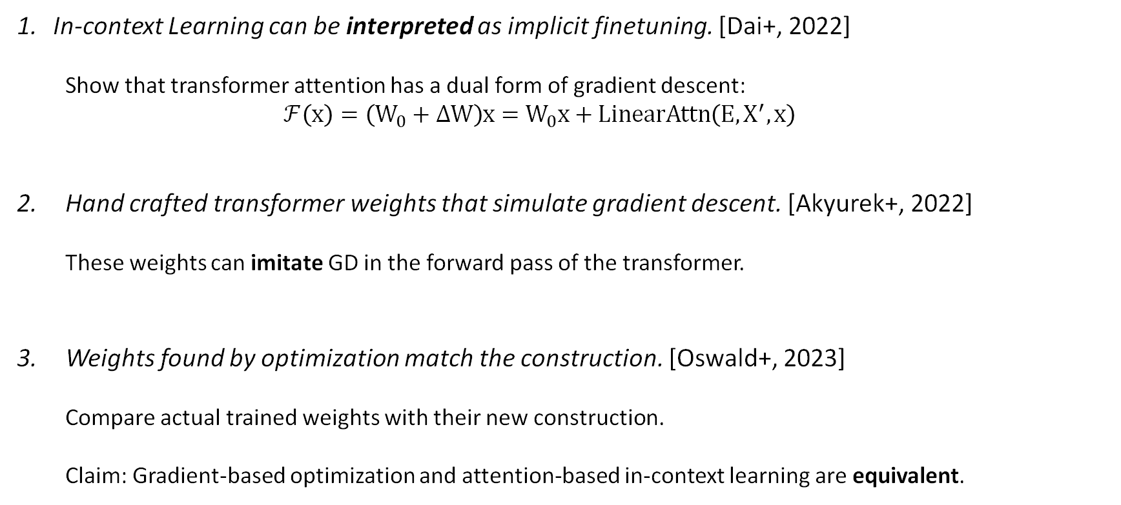
Evolution of this theory
In-context Learning can be interpreted as implicit finetuning. [Dai+, 2022]
Show that transformer attention has a dual form of gradient descent:
$$ℱ\left(x\right)=\left(W_{0}+ΔW\right)x=W_{0}x+LinearAttn\left(E, X^{′},x\right)$$
Hand crafted transformer weights that simulate gradient descent. [Akyurek+, 2022]
These weights can imitate GD in the forward pass of the transformer.
Weights found by optimization match the construction. [Oswald+, 2023]
Compare actual trained weights with their new construction.
Claim: Gradient-based optimization and attention-based in-context learning are equivalent.
Dai, Damai, et al. "Why can gpt learn in-context? language models implicitly perform gradient descent as meta-optimizers." arXiv preprint arXiv:2212.10559 (2022).
Akyürek, Ekin, et al. "What learning algorithm is in-context learning? investigations with linear models." arXiv preprint arXiv:2211.15661 (2022).
Von Oswald, Johannes, et al. "Transformers learn in-context by gradient descent." International Conference on Machine Learning. PMLR, 2023.
8
Notes:
This line of work has evolved over time.
It started with an interpretation of transformer attention as a dual form of gradient descent.
Next, it was shown that if inputs are presented in a certain format, we can hand-construct weights that would simulate a step of gradient descent in the forward pass of a transformer. They trained transformers with a special objective, to perform ICL on linear regression tasks.
Finally, it was claimed that not only do these weights exist, but trained transformers actually mimic gradient descent, and ICL is essentially equivalent to GD. Note that we are showing these works just to highlight some of the original ideas in this domain, but their setup is broadly adopted in many follow-up works.
##### SCRATCH
, where the error signals, in-context inputs and the query input are interpreted as values, keys and queries of the transformer attention respectively.

Slide 9
The “ICL Objective” problem
Notes:
But there is one big problem with most of these formulations, the ICL objective.

Slide 10
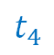
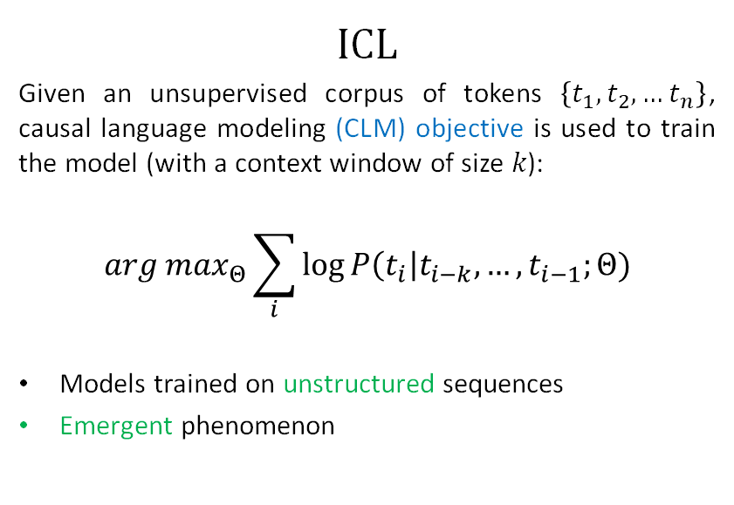
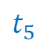
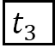
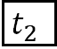
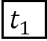
$$ICL$$
Given an unsupervised corpus of tokens $\left\{t_{1},t_{2},…t_{n}\right\}$, causal language modeling (CLM) objective is used to train the model (with a context window of size 𝑘):
$$arg max_{Θ}\sum_{i}{log}{P\left(t_{i}\right|t_{i−k},…,t_{i−1};Θ)}$$
Models trained on unstructured sequences
Emergent phenomenon
$$t_{1}$$
$$t_{2}$$
$$t_{3}$$
Transformer
$$t_{1}$$
$$t_{2}$$
$$t_{3}$$
$$t_{4}$$
$$t_{5}$$
Transformers, pretrained with CLM objective, yield emergent ICL.
10
Notes:
ICL, as we understand it, emerges in models trained as follows.
You take a corpus of tokens and train the model with the causal language modeling objective.
In other words, you take an unstructured sequence of tokens, and train the model to predict the next token. Unstructured, as in they do not explicitly follow the prompt structure of (x, y) pairs from ICL queries.
So you never train the models to understand the ICL structure, but still get this emergent phenomenon in this family of models.

Slide 11
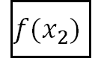
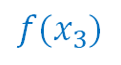
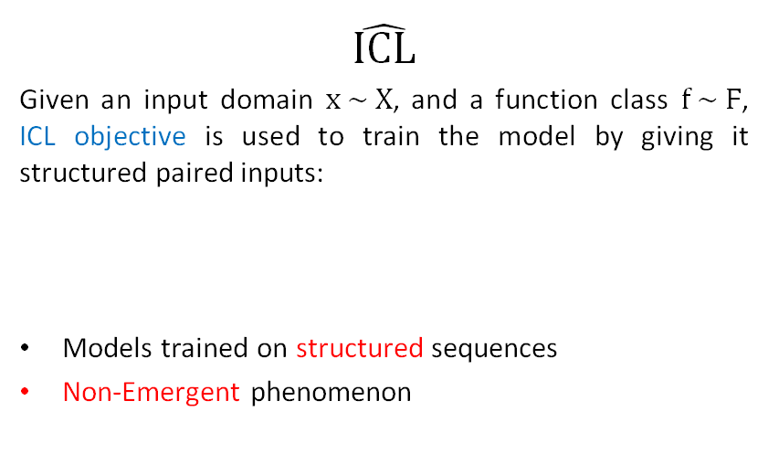
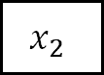
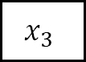
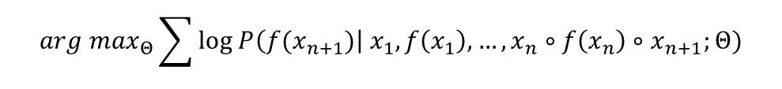
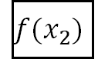
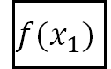
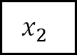
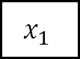

Our new terminology
$$\hat{ICL}$$
Given an input domain $x \sim Χ$, and a function class $f \sim Ϝ$, ICL objective is used to train the model by giving it structured paired inputs:
Models trained on structured sequences
Non-Emergent phenomenon
$$x_{1}$$
$$f(x_{1})$$
$$x_{2}$$
$$f(x_{2})$$
$$x_{3}$$
Transformer
$$arg \max_{Θ}{\sum{log P\left({f(x}_{n+1})\right|{ x}_{1},f\left(x_{1}\right), …, x_{n}∘f\left(x_{n}\right)∘x_{n+1};Θ)}}$$
$$x_{1}$$
$$f(x_{1})$$
$$x_{2}$$
$$f(x_{2})$$
$$x_{3}$$
$$f(x_{3})$$
Transformers trained with ICL objective, yield non-emergent meta learning.
11
Notes:
On the other hand, when you train a model using the ICL objective, you are taking samples from an input domain, applying a function on them, and then creating a prompt for the model.
In other words, you take some xs, their corresponding ys and fill up the input window with this (x, y) pair sequence structure, and ask the model to predict the y for the last x.
This trains the model to always expect this structure in the input, and hence it learns to “meta-learn” the exhibited function f. But this is not an emergent phenomenon. These models have hardcoded understanding of the ICL structure and hence, uncomparable to LLMs.
We call this space of models ICL hat to distinguish it from ICL models.

Slide 12
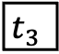
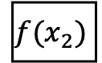
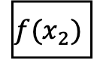
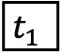

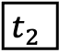
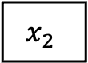
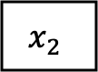
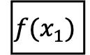
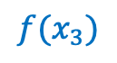
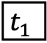
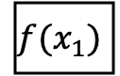
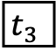
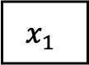

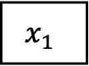
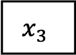
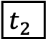
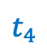
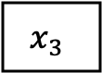

$$ICL$$
$$\hat{ICL}$$
$$≠$$
$$x_{1}$$
$$f(x_{1})$$
$$x_{2}$$
$$f(x_{2})$$
$$x_{3}$$
$$t_{1}$$
$$t_{2}$$
$$t_{3}$$
Transformer
Transformer
$$t_{1}$$
$$t_{2}$$
$$t_{3}$$
$$t_{4}$$
$$x_{1}$$
$$f(x_{1})$$
$$x_{2}$$
$$f(x_{2})$$
$$x_{3}$$
$$f(x_{3})$$
Emergent
Non-emergent
Notes:
Therefore,
Emergent ICL is not the same phenomenon as the artificial ICL hat.

Slide 13
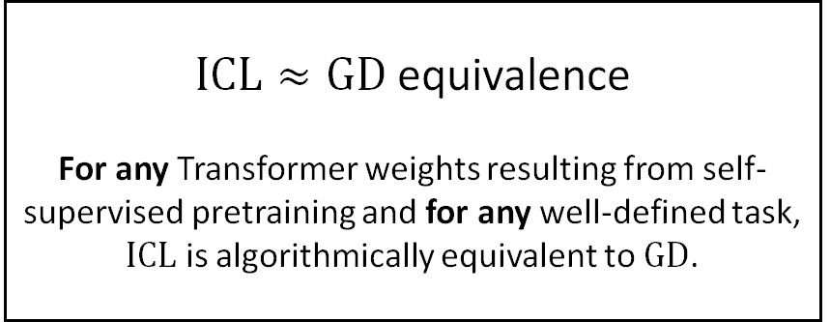
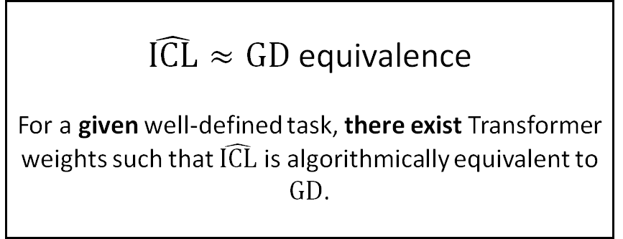
What they imply
What they show
$ICL≈GD$ equivalence
For any Transformer weights resulting from self-supervised pretraining and for any well-defined task, $ICL$ is algorithmically equivalent to $GD$.
$\hat{ICL}≈GD$ equivalence
For a given well-defined task, there exist Transformer weights such that $\hat{ICL}$ is algorithmically equivalent to $GD$.
Transformers have the expressive capacity to simulate GD.
This does not imply that LLMs actually do simulate it.
13
Notes:
What these works imply is the ICL – GD equivalence, that is: for any transformer weights resulting from self-supervised pretraining on a corpus of tokens, and for any well-defined task, ICL and GD are algorithmically equivalent.
But what they actually show is ICL hat – GD equivalence, that is: for a given well-defined task (or function class), there exist transformer weights that work identically to explicit gradient descent on an internal model.
Therefore, even though these recent works show that transformers can express gradient descent in their forward pass, it does not imply that LLMs really do.

Slide 14
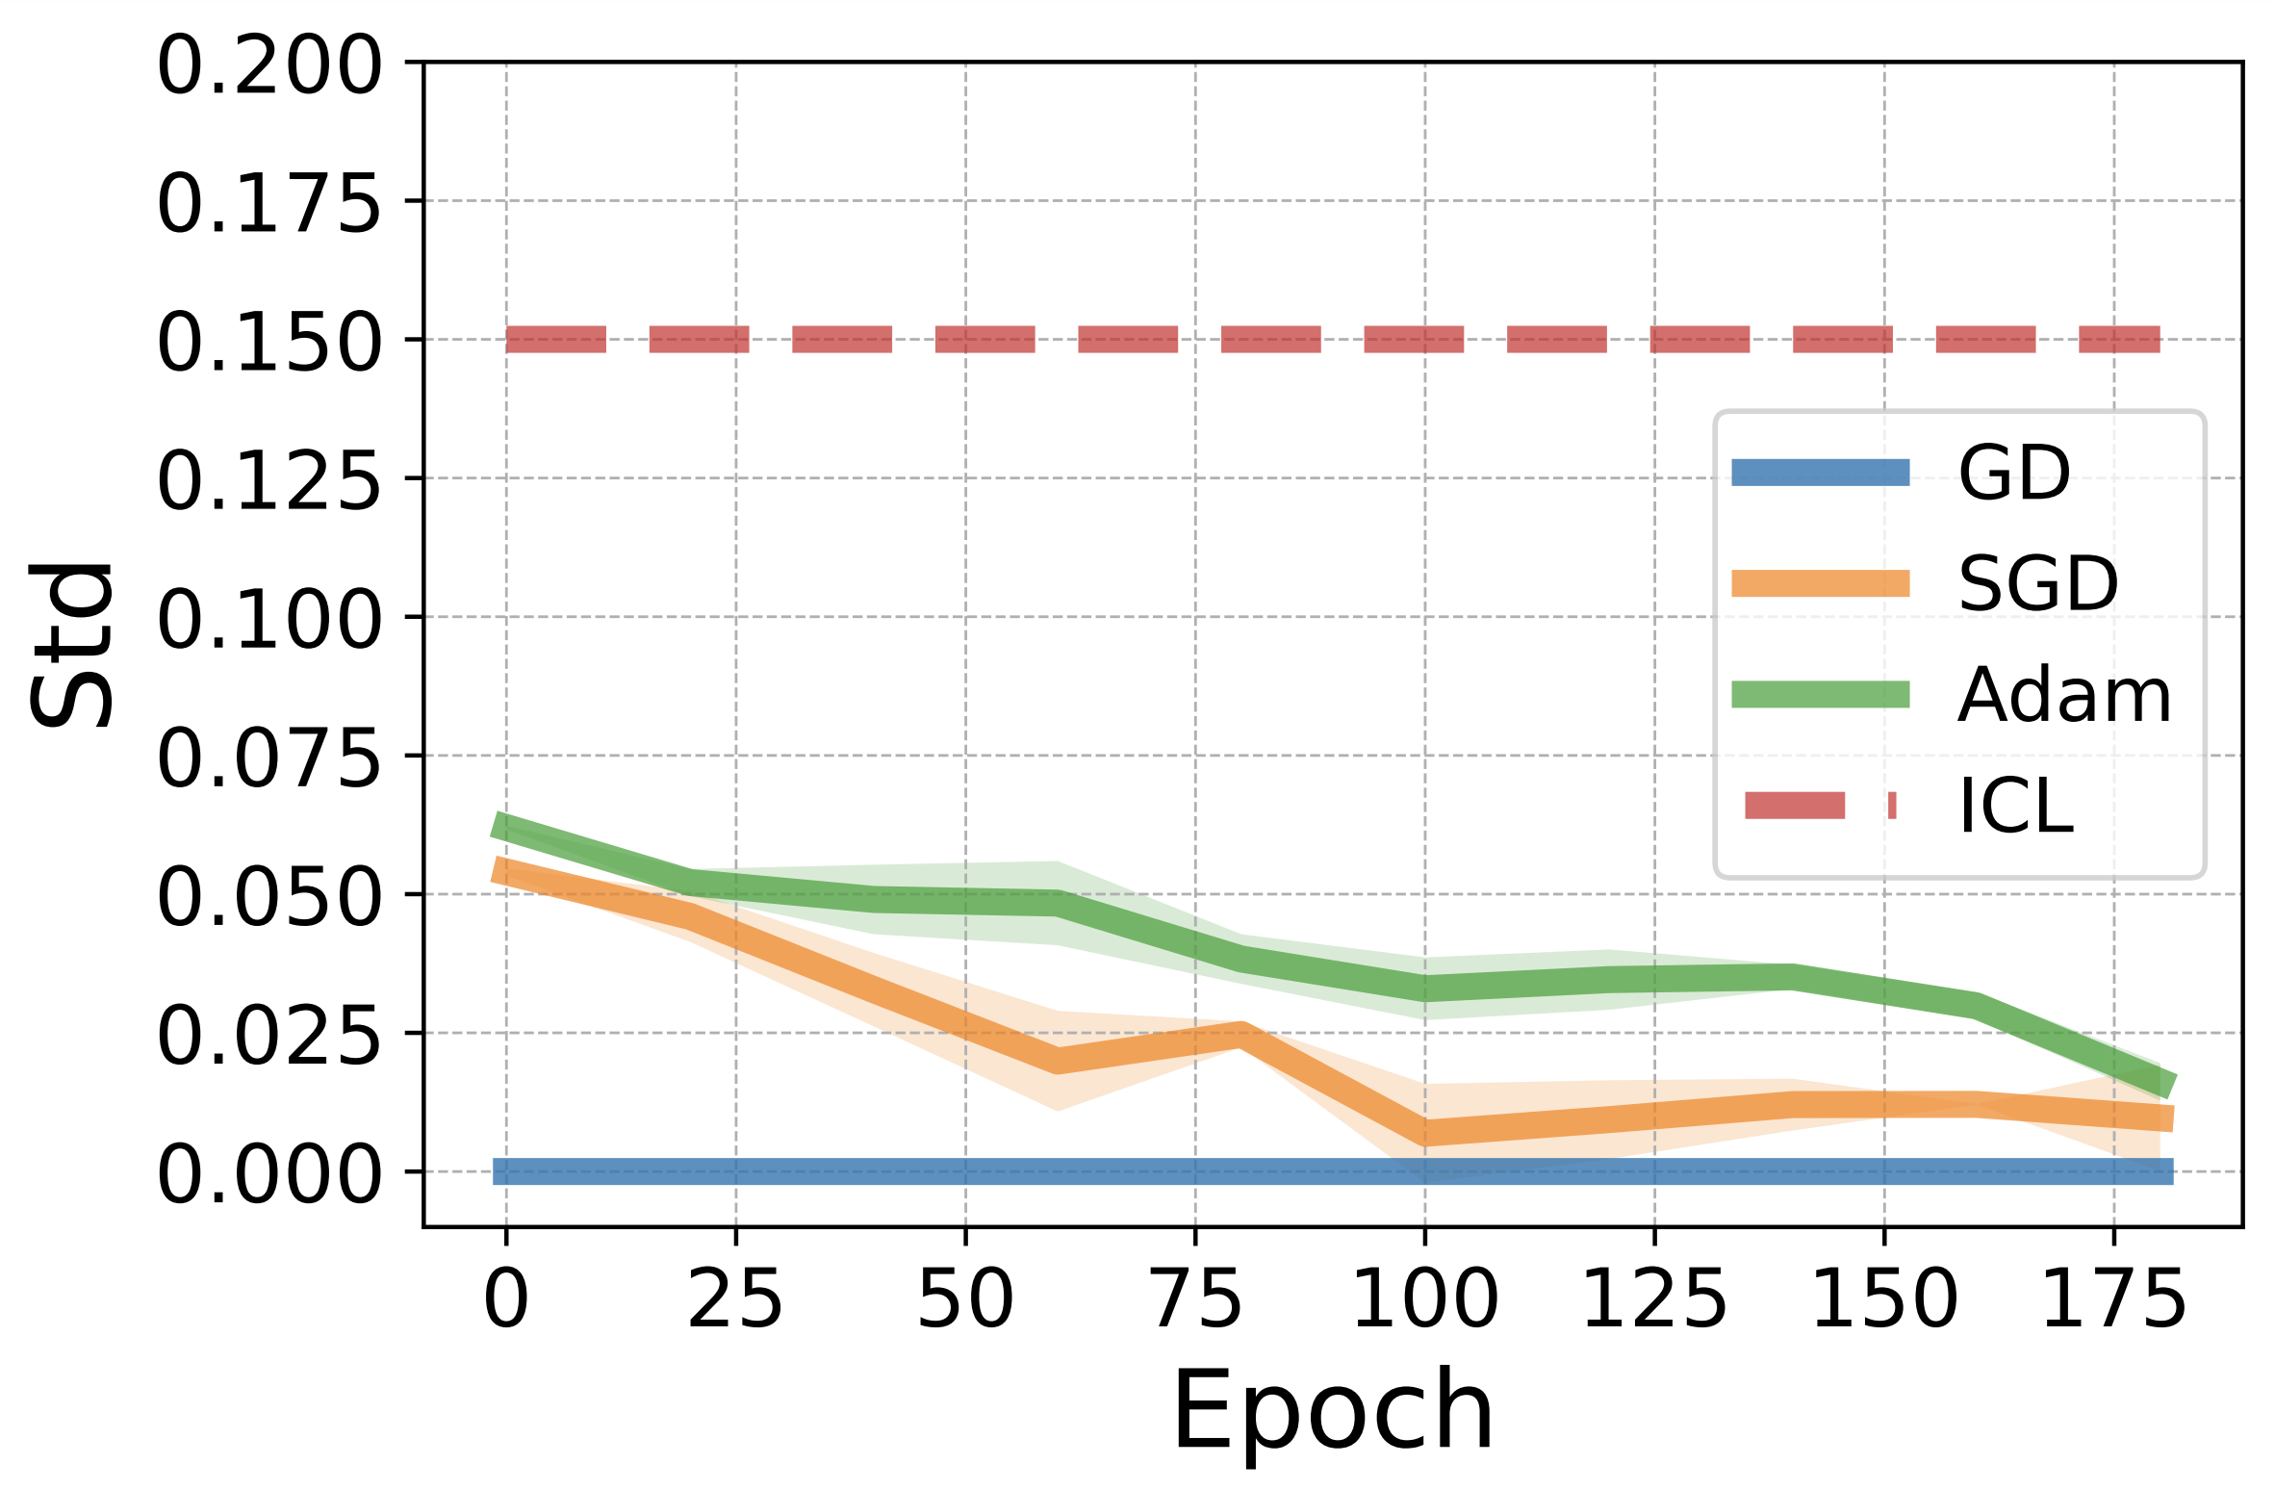
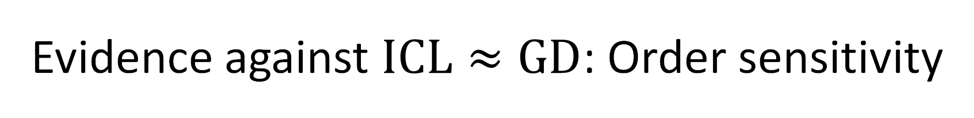
Evidence against $ICL≈GD$: Order sensitivity
ICL is known to be highly order-sensitive [Lu+].
GD is order-insensitive. contradicts [Oswald+]
Variants of GD are still not as sensitive as ICL. undermines [Akyurek+]
ICL is likely not equivalent to GD based on order sensitivity.
Akyürek, Ekin, et al. "What learning algorithm is in-context learning? investigations with linear models." arXiv preprint arXiv:2211.15661 (2022).
Von Oswald, Johannes, et al. "Transformers learn in-context by gradient descent." International Conference on Machine Learning. PMLR, 2023.
Lu, Yao, et al. "Fantastically ordered prompts and where to find them: Overcoming few-shot prompt order sensitivity." arXiv preprint arXiv:2104.08786 (2021).
14
Notes:
Next, we present evidence against this equivalence in real LLMs.
In the paper, we presented a definition of equivalence which directly implies an equivalence in order-sensitivity.
We know that LLMs are highly order sensitive. In fact, we plotted the order-sensitivity of the LLaMa model on one task as the standard deviation in its output probabilities of individual tokens and see this high sensitivity.
However, GD is order-insensitive. This directly contradicts the formulation of one of the previous works.
We also plot the order-sensitivity of variants of GD like SGD and Adam. ICL is a lot more sensitive than these as well. This undermines another formulation that allows for order sensitivity.

Slide 15








Evidence against $ICL≈GD$: Weight Sparsity
Hand constructed weights and inputs in [2] are highly sparse.
Constructions of [3] are similarly sparse.
Akyürek, Ekin, et al. "What learning algorithm is in-context learning? investigations with linear models." arXiv preprint arXiv:2211.15661 (2022).
Von Oswald, Johannes, et al. "Transformers learn in-context by gradient descent." International Conference on Machine Learning. PMLR, 2023.
15
Notes:
Another evidence against the presented formulations comes from the sparsity in the hand-constructed weights.
These hypothetical weights are highly sparse, consisting a lot of zeros.
The non-zero entries in these matrices are typically Identity matrices, which are mostly zeros as well. So, for this formulation to work, the transformer weights have to be >99% zeros at some positions.

Slide 16

Evidence against $ICL≈GD$: Weight Sparsity
Real LLMs are rather dense.
16
Notes:
However real LLMs are not sparse. We plot the percentage of parameters with absolute values less than a certain small threshold. Even with a lenient threshold, we find that the LLaMA model weights are quite dense, compared to these theoretical constructions.

Slide 17



Evidence against $ICL≈GD$: Weight Evolution
ICL ability remains stable even when weights keep evolving.
To claim $ICL≈GD$, showing it for a single sparse choice of parameters is not enough.
17
Notes:
Moreover, if we plot the performance of a language model on some ICL task over time during training, we see that the ability stabilizes after some point while the parameters keep updating. This is a snapshot of GPT-J model at different training checkpoints.
Therefore, showing that an equivalence exists for a single choice of sparse parameters is not enough to claim a stronger hypothesis.

Slide 18


Evidence against $ICL≈GD$: Performance
We use three coarse-to-fine metrics to compare ICL and GD:
Accuracy: compare top predicted tokens against the ground truth (instead of top predicted label).
Token Overlap: compare overlap in top-K tokens of two distributions.
Overlap Cosine Similarity: compare the individual agreement between top-K tokens.
18
Notes:
Finally, we also observe differences between ICL and GD outputs on different tasks.
We employ three metrics which compare them at a coarse as well as fine resolution.
Accuracy is measured against the whole vocabulary, instead of just label set.
Token overlap, looks at the intersection rate of top-K tokens from both outputs.
And Overlap Cosine Similarity goes even further and compares the individual agreement between top-K tokens. For ICL, the demonstrations are shown in context. For GD models, the same demonstrations are used to finetune the model (with various learning rates), which is then only shown the query input.

Slide 19




Evidence against $ICL≈GD$: Outputs
Between different ICL outputs
Accuracy
Overlap Cosine Similarity
Token Overlap
Between ICL and GD outputs
ICL performs differently and does not align with GD.
19
Notes:
In terms of accuracy, we find that GD models finetuned with a variety of learning rates all saturate in performance quickly after a few epochs because of the limited number of demonstrations used for training.
In contrast, ICL is much more sample efficient and performs quite better resulting in a big gap in performance.
In terms of Token overlap, we see consistent disagreement between ICL and GD outputs. Here, the ICL line denotes the token overlap between ICL outputs resulting from different order of demonstrations. We see that there is high agreement between them. In contrast, all GD outputs disagree with ICL outputs, suggesting that the two methods have different functional form.
Overlap Cosine similarity paints a similar picture.

Slide 20

Summary
Recent works studying ICL do not align with emergent ICL in LLMs. In-Context Learning → Learning to Learn, Meta Learning, etc. Transformers learn in-context by gradient descent → Transformers can perform gradient descent in their forward pass when trained appropriately.
Expressivity of the Transformer architecture to simulate GD does not imply that LLMs actually do it. We present arguments and evidence against the [current] $ICL≈GD$ equivalence theory.
Maintain parallels to real world settings when developing. It is OK to study ICL in a simpler setting like Linear Regression, but need to find a corresponding pretraining distribution to elicit ICL.
20
Akyürek, Ekin, et al. "What learning algorithm is in-context learning? investigations with linear models." arXiv preprint arXiv:2211.15661 (2022).
Von Oswald, Johannes, et al. "Transformers learn in-context by gradient descent." International Conference on Machine Learning. PMLR, 2023.
Notes:
In summary,
We show that recent works study ICL through an inappropriate lens which may hamper our progress towards understanding the real emergent ICL. We see lots of papers following this problematic setup to study ICL when they are actually studying ICL hat. We ask the community to refrain from from using established terminology for new phenomenon. For example, instead of calling it In-Context Learning, it can be called Learning to Learn, or Meta Learning in transformers. And instead of a making potentially misleading claims like transformers learn “in-context” by gradient descent, an accurate statement could be “transformers can perform gradient descent in their forward pass when trained appropriately”.
We show that the expressive capacity of the Transformer to simulate does not mean that real-world LLMs do the same, and present evidence against the current ICL – GD equivalence theory.
Lastly, developing theories by studying simpler settings is often necessary to deal with the complexity of real world, but it is essential to maintain parallels to it to not drift from the original goals. For instance, it is OK to study ICL in linear regression problems but then one needs to find a corresponding unstructured pretraining distribution that can elicit ICL in such models.

Slide 21


Thank you!
Paper
Contact
Notes:
Thank you for your time, and I open the floor for further discussion on the topic.

Slide 22








An SA Layer vs. a GD update
[Von Oswald et al. 2023]
Linear Model
Notes:
where our training harnesses do gradient descent on the weights of the model, updating them once per training step, GPT performs gradient descent on the activations of the model, updating them with each layer. This would be big if true! Finally, an accidental mesa-optimizer in the wild.
By rearranging the equation for gradient descent, you can think of a step of gradient descent as being an update to the data, rather than an update to the weights.

Slide 23









Results: Transformers can implement GD
!= does
[Von Oswald et al. 2023; others]
$${\hat{y}}_{test}$$
$${\hat{y}}_{test}=f({ x}_{test};w_{}^{3})$$
$$w_{}^{3}=w_{}^{2}−\frac{η}{N}\sum_{i=1}^{N}{∇ℓ(f\left(x_{i}\right), y_{i})}$$
$$h_{3}^{out}$$
Self-Attention Layer
$$w_{}^{2}=w_{}^{1}−\frac{η}{N}\sum_{i=1}^{N}{∇ℓ(f\left(x_{i}\right), y_{i})}$$
$$h_{2}^{}$$
Self-Attention Layer
$$w_{}^{1}=w_{}^{0}−\frac{η}{N}\sum_{i=1}^{N}{∇ℓ(f\left(x_{i}\right), y_{i})}$$
$$h_{1}^{}$$
Self-Attention Layer
$$w_{}^{0}$$
gradients of the empirical loss on the demonstrations
$$x_{1}, y_{1}, …, x_{N}, y_{N}, { x}_{test}$$
demonstrations
Notes:
Importantly, at no point do we have to keep track of the weights of the model. We can do training and inference, simultaneously

Slide 24
Our recommendations
Refrain from using established terminology inappropriately to avoid confusion.
Avoid misleading statements.
Transformers learn in-context by gradient descent → Transformers can perform gradient descent when trained appropriately
Maintain parallels to real world settings when developing theories in lab.
It is OK to study ICL in a simpler setting like Linear Regression, but need to find a corresponding pretraining distribution to elicit ICL.
24
Notes:
Following our position:
We ask authors to refrain from using established terminology like In-Context Learning to denote new phenomenon, to avoid confusion. Instead, they can use terms like learning to learn from context, or meta learn, etc.
We also ask them them to make accurate statements to avoid confusion.
Finally, developing theories by studying simpler settings is often necessary to deal with the complexity of real world, but it is essential to maintain parallels to the real world to not drift from the original goals. For example, training with the ICL objectives changes the space of models drastically and hence the inferences drawn from these studies can not directly be applied to LLMs. Instead, we should find other pretraining distributions that can elicit emergent ICL, and test the theories in real world models to validate them. We don't want to pinpoint these works, there are a lot of similar works.

Slide 25

Evidence against $ICL≈GD$: Performance
Comparing the top prediction in the label set doesn’t paint the whole picture.
Possible values:
World, Sports, Business, Tech
Input: Apple recalls 15in PowerBook batteries
Output: Tech
Input: Major attack by rebels on Nepalese town
Output: World
...
Input: Rookie Taylor Wins Playoff at Reno-Tahoe
Output:
ICL
LLM
GD
LLM
Input: Rookie Taylor Wins Playoff at Tahoe
Output:
Is this suitable to evaluate the equivalence hypothesis?
25
Notes:
Now, some empirical evidence.
Before presenting numbers, we would like to highlight that when evaluating model performance on classification tasks, often times only the label set is analyzed.
For example, a comparison in this case would mean comparing the probability mass on the 4 possible class labels.
But does this approach evaluate the equivalence hypothesis well?

Slide 26
Looking deeper
ICL
GD
ICL
LLM
GD
LLM
ICL and GD modify LLM distributions differently!
26
Notes:
If we look deeper,
the distribution over the whole vocabulary set looks quite different.

Slide 27



The “ICL Objective” problem
$$\hat{ICL}$$
Given an input domain $x \sim Χ$, and a function class $f \sim Ϝ$, ICL objective is used to train the model by giving it structured paired inputs:
Models trained on structured sequences
Non-Emergent phenomenon
$$arg \max_{Θ}{\sum{log P\left({f(x}_{n+1})\right|{ x}_{1},f\left(x_{1}\right), …, x_{n}∘f\left(x_{n}\right)∘x_{n+1};Θ)}}$$
$\hat{ICL}$ is a different space of models with explicit understanding of ICL input structure.
LLMs are not pretrained with ICL objective.
27
Notes:
But there is one big problem with some of their formulations, the ICL objective, which is used to train their transformers.
If you look at ICL as we understand it from LLMs, it is an emergent phenomenon exhibited by models pretrained on unstructured sequences.
Unstructured as in they do not explicitly follow the prompt structures from ICL queries. You take a corpus of tokens and train the model with the causal language modeling objective.
On the other hand, when you train a model using the ICL objective (a family of models that we call ICL hat), you are taking samples from an input domain, applying a function on them, and creating the prompt to follow this (x, y) pair sequence structure. This trains the model to always expect this structure in the input, and hence it learns to solve the problem. But this can not be called an emergent phenomenon.
ICL hat is a different space of model with hardcoded understanding of the ICL structure. Therefore, these studied transformers are uncomparable to LLMs which are not pretrained with the ICL objective.

Slide 28

The evolution
In-context Learning can be understood as implicit finetuning. [Dai et al, 2022]
Transformer attention has a dual form of gradient descent:
$$ℱ\left(x\right)=\left(W_{0}+ΔW\right)x=W_{0}x+LinearAttn\left(E, X^{′},x\right)$$
where error signals from in-context demos $E$ are interpreted as values, in-context inputs $X^{′}$ as keys and current input $x$ (for in-context inference) as the query.
We can define transformer weights that simulate gradient. [Akyurek et al, 2022]
Given inputs in a required form, there exist transformer weights which produce an output equal to one produced by an internal model that is updated by given demos using gradient descent.
Weights found by optimization match the construction. [von Oswald et al, 2023]
Not only do transformer weights that can simulate gradient descent exist, but trained transformers do mimic gradient descent on linear regression tasks. Gradient-based optimization and attention-based in-context learning are equivalent.
Notes:
This line of work has evolved over time.
It started with an interpretation of transformer attention as a dual form of gradient descent, where the error signals, in-context inputs and the new input are interpreted as values, keys and queries of the transformer attention.
Next, it was shown that if inputs are presented in a certain format, we can hand-construct weights that would simulate a step of gradient descent in the forward pass of a transformer.
Finally, it was claimed that not only do these weights exist, but trained transformers actually mimic gradient descent on some toy tasks, and GD is essentially equivalent to in-context learning.

Slide 29


Evidence against $ICL≈GD$: Empirical
We use three coarse-to-fine metrics to compare ICL and GD:
Accuracy: compare top predicted tokens against the ground truth (instead of top predicted label).
Token Overlap: compare overlap in top-K tokens of two distributions. Let, $O= T_{K}^{1}∩T_{K}^{2}$
Token Overlap = $\frac{1}{K}|O|$
Overlap Cosine Similarity: compare the individual agreement between top-K tokens.
$$\frac{\sum_{t∈O}{p_{1}\left(t\right). p_{2}(t)}}{\sqrt{\sum_{t∈O}{p_{1}{\left(t\right)}^{2}}.\sum_{t∈O}{p_{1}{\left(t\right)}^{2}}.(K −\left|O\right|)}}$$
Notes:
They’re compression engines, that are trained to denoise their input.
(without loss of generality, we train them to predict the next token).

Slide 30
Language Models
Background
Johns Hopkins University is in _______.
LM
Baltimore
Simple facts
[Bengio et al. ‘04, Peters et al. ‘18, Raffel et al. ‘20, Brown et al. ’20, many others]

Slide 31
In-context learning emerges from pre-training
Background
Input: JHU Output: Baltimore
Input: UMD Output: DC
Input: NYU Output:
LM
New York
[Brown et al., 2020]

Slide 32
In-context learning emerges from pre-training
Background
Input: JHU Output: Baltimore
Input: UMD Output: DC
Input: NYU Output:
LM
New York
Input: JHU Output: private
Input: UMD Output: public
Input: NYU Output:
LM
private
[Brown et al., 2020]
Notes:
In 2020, in the original GPT-3 paper, OpenAI claimed that language models are few shot learners. Nobody at OpenAI was trying to build a few-shot learner—they were trying to build a next-word predictor, and the interesting thing is that they got a few-shot learner for free.

Slide 33


This is an old dream come true!
Background
Case-based reasoning, rule-induction, dynamic memory, analogical reasoning, …
[Google n-grams]
Notes:
Just to further emphasize how amazing ICL is, the underlying ability was actively perused in the old literature, many years ago.
but all those efforts failed and died down before the turn of century, as you can see in the n-gram trends I have extracted
--------
Case-based reasoning: the process of solving new problems based on the solutions of similar past problem

Slide 34
In-context learning: well-studied yet elusive.
What we understand:
ICL improves with scale. [Brown et al. 2020; Srivastava et al. 2023]
ICL is brittle. [Min et al., 2022; Mishra et al., 2022]
ICL as a probabilistic inference. [Muller et al. 2021; Xie et al. 2021]
Still no framework that fully explains and predicts its nuts and bolts.
Notes:
As you all know, there has been a ton of work on ICL.

Slide 35



Explaining ICL via Gradient Descent
Is it possible that ICL is secretly executing GD during inference?
We have known GD for a long-time.
ICML 2023
Dai et al. 2022; Garg et al. 2022; Zhang et al. 2023; Ahn et al. 2023; Raventos et al. 2023; Li et al. 2023; Guo et al. 2023; …
ICLR 2023
Notes:
Recently, a compelling theory has been floating around the memesphere that GPT learns in context the way our training harnesses do on datasets: via some kind of gradient descent.
- We have know this algorithms for a long time, since 60s.
- So, connecting ICL (a mysterious phemonon) with something that we something that we kinda understand sounds like an exciting idea.
- You probability have seen some of these works,
If you’re also like me, fascinated by ICL, then your reaction to all these stream of works should not be any less than "oh my god I am panicking”
With show of hands, how many people are following this literature?

Slide 36

Basic idea: gradient computation in forward process
Gradient descent
Forward propagation
(photo credit: Blaine on lesswrong)
Notes:
GPT first, construct some representation of a model and loss function in activation space, based on the training examples in the prompt

Slide 37


A Self-Attention (SA) Layer
$$h_{}^{out}=SA(h_{}^{in}; W_{q}, W_{k}, W_{v})$$
$$h_{}^{out}$$
Self-Attention Layer
$$h_{}^{in}$$

Slide 38
A Self-Attention (SA) Layer
$$h_{}^{out}=h_{}^{in}+ SA(h_{}^{in}; W_{q}, W_{k}, W_{v})$$
$$h_{}^{out}$$
Self-Attention Layer
$$h_{}^{in}$$

Slide 39
An SA Layer vs. a GD update
$$h_{}^{out}=h_{}^{in}+ SA(h_{}^{in}; W_{q}, W_{k}, W_{v})$$
Each layer simulates an implicit gradient update?
$$w_{}^{t+1}=w_{}^{t}−η×∇ℒ$$
Notes:
where our training harnesses do gradient descent on the weights of the model, updating them once per training step, GPT performs gradient descent on the activations of the model, updating them with each layer. This would be big if true! Finally, an accidental mesa-optimizer in the wild.
By rearranging the equation for gradient descent, you can think of a step of gradient descent as being an update to the data, rather than an update to the weights.

Slide 40
An SA Layer vs. a GD update
[Von Oswald et al. 2023]
Linear Model
Notes:
where our training harnesses do gradient descent on the weights of the model, updating them once per training step, GPT performs gradient descent on the activations of the model, updating them with each layer. This would be big if true! Finally, an accidental mesa-optimizer in the wild.
By rearranging the equation for gradient descent, you can think of a step of gradient descent as being an update to the data, rather than an update to the weights.

Slide 41
Results: Transformers can implement GD
!= does
[Von Oswald et al. 2023; others]
$${\hat{y}}_{test}$$
$${\hat{y}}_{test}=f({ x}_{test};w_{}^{3})$$
$$w_{}^{3}=w_{}^{2}−\frac{η}{N}\sum_{i=1}^{N}{∇ℓ(f\left(x_{i}\right), y_{i})}$$
$$h_{3}^{out}$$
Self-Attention Layer
$$w_{}^{2}=w_{}^{1}−\frac{η}{N}\sum_{i=1}^{N}{∇ℓ(f\left(x_{i}\right), y_{i})}$$
$$h_{2}^{}$$
Self-Attention Layer
$$w_{}^{1}=w_{}^{0}−\frac{η}{N}\sum_{i=1}^{N}{∇ℓ(f\left(x_{i}\right), y_{i})}$$
$$h_{1}^{}$$
Self-Attention Layer
$$w_{}^{0}$$
gradients of the empirical loss on the demonstrations
$$x_{1}, y_{1}, …, x_{N}, y_{N}, { x}_{test}$$
demonstrations
Notes:
Importantly, at no point do we have to keep track of the weights of the model. We can do training and inference, simultaneously

Slide 42
Results: Transformers can implement GD
!= does
[Von Oswald et al. 2023; others]
Theorem [von Oswald et al., among others]: There exists self-attention weights that, ICL simulates GD, for a fixed well-defined task family.
How strong of a claim are we making here? Do they hold in real practice?
Notes:
Importantly, at no point do we have to keep track of the weights of the model. We can do training and inference, simultaneously

Slide 43
What existing work shows:
∃
✓
Theorem [von Oswald et al., among others]: There exists self-attention weights that, ICL simulates GD, for a fixed well-defined task family.
Do the existing results generalize to realistic settings?
What is more interesting and realistic:
∀
?
Hypothesis [ICL≈GD hypothesis]: For any pre-trained Transformer weights , ICL is equivalent to GD, for any well-defined task family.
Notes:
…
It’s really hard to prove or disprove this. Or at least, we couldn’t do it.
Instead, what instead did we look at the empirical evidence.

Slide 44



Do Pretrained Transformers Learn In-Context by Gradient Descent?
ICML 24
Lingfeng Shen*, Aayush Mishra*, Daniel Khashabi
https://arxiv.org/abs/2310.08540
Notes:
… where we do a reality-check on the results regarding equivalence between ICL and GD.

Slide 45

ICL vs GD: Distributional Mismatch
Training with the ICL objective
Input: JHU Output: Baltimore
Input: UMD Output: DC
Input: NYU Output:
LLMs are not trained this way!
This explicit structure provided in the input makes the setting different from LLMs.
Notes:
You can also compare ICL and GD, based on model’s output on a particular task.
As a base case,

Slide 46

How realistic is it to proves ICL≈GD for fixed weights?
GPT-J's ICL ability does not change much over time during training, while the parameters change steadily.
There are many ICL-inducing parameters.
Therefore, to prove ICL≈GD hypothesis, showing it for a single choice of parameters is not enough.

Slide 47

ICL vs GD: End task comparison
Possible values:
World, Sports, Business, Tech
Input: Rookie Taylor Wins Playoff at Tahoe
Output:
LM
Input: Apple recalls 15in PowerBook batteries
Output: Tech
Input: Major attack by rebels on Nepalese town
Output: World
...
Input: Rookie Taylor Wins Playoff at Reno-Tahoe
Output:
In-context
demonstrations
LM
Gradient-descent
Input: Rookie Taylor Wins Playoff at Tahoe
Output:
LM
Notes:
You can also compare ICL and GD, based on model’s output on a particular task.
As a base case,

Slide 48
ICL vs GD: End task comparison
Possible values:
World, Sports, Business, Tech
Input: Apple recalls 15in PowerBook batteries
Output: Tech
Input: Major attack by rebels on Nepalese town
Output: World
...
Input: Rookie Taylor Wins Playoff at Reno-Tahoe
Output:
In-context
demonstrations
LM
Gradient-descent
Hypothesis: If two adaptation algorithms consistently lead to the same distribution on any tasks, they must be equivalent.
Input: Rookie Taylor Wins Playoff at Tahoe
Output:
LM
Notes:
You can also compare ICL and GD, based on model’s output on a particular task.
As a base case,

Slide 49
ICL vs GD: End task comparison
Possible values:
World, Sports, Business, Tech
Input: Apple recalls 15in PowerBook batteries
Output: Tech
Input: Major attack by rebels on Nepalese town
Output: World
...
Input: Rookie Taylor Wins Playoff at Reno-Tahoe
Output:
In-context
demonstrations
LM
Gradient-descent
≈
Input: Rookie Taylor Wins Playoff at Tahoe
Output:
LM
Can we take this as an evidence for ICL ≈GD?
Notes:
You can also compare ICL and GD, based on model’s output on a particular task.
As a base case,

Slide 50
Full distributions over vocabulary are quite different!
In-context
Gradient-descent
In-context
LM
Gradient-descent
LM
ICL vs GD modify LLM distributions differently..
Notes:
You can also compare ICL and GD, based on model’s output on a particular task.
As a base case,

Slide 51
ICL
GD
Overlap(k=10)=50%
top-k
Overlap(k): % commonality across top-k tokens of two distributions
Notes:
You can also compare ICL and GD, based on model’s output on a particular task.
As a base case,

Slide 52


ICL vs GD modify LLM distributions differently.
ICL vs GD (lr=1e-3)
ICL vs GD (lr=1e-4)
ICL vs GD (lr=1e-5)
ICL vs GD (lr=1e-6)
ICL vs ICL
Overlap(k=10)

Slide 53
ICL vs GD modify LLM distributions differently.
Overlap(K)

Slide 54

ICL vs GD have different order-sensitivity.
Prior research has demonstrated that ICL is highly sensitive to the order of in-context sample [Lu et al. 2022].
GD and its variants are more order-stable (less STD).
Standard deviation token probabilities, for different choices of demonstrations.

Slide 55
Summary Thus Far
The explanations of ICL based on GD are quite intriguing — do they hold in practice?
In practice, we did not see any evidence that ICL simulates GD.
See the paper for more arguments and analysis.
Note, we’re not refuting it. It’s left open for future research.
Deep inside, I believe that there must be a connection between ICL and optimization algorithms — we’re just not looking at it right.
Notes:
It would demystify transformers' magical powers of in-context learning. We don't understand much about gradient descent, but we understand it a hell of a lot better than we currently understand GPT.
It would unlock new avenues of research; understanding which functions GPT is optimising and why could tell us a lot about its generalization behaviour.

Slide 56
ICL remains understudied and elusive.
ICL is an important & mysterious phenomenon.
… we don’t know how to explain it.
… and we are getting used to it.
Many open problems:
Under what conditions does it emerge? (e.g., distributional properties)
Does ICL need natural language? Can it emerge, e.g., on brain signals?
Notes:
We are getting used to it like gravity.
Almost all of us take gravity a given fact of life and never think about. Newton didn’t, and he discovered something new.
With ICL we have made major dents in some of the most difficult problems in AI, such as analogical reasoning.
Mind you, folks like Douglas Hostader that view analogical reasoning as the foundation of cognition and for ICL.

Slide 57
ICL is likely what makes “alignment” effective.
The success of LLMs in following instructions can be viewed from the lens of ICL.
Being able to make LLMs adapt to various in-context demonstration was an early sign that LLMs can be controlled.
To understand limits of controlling LLMs, we must understand limits of ICL.
Notes:
Like gravity.
– Many took gravity for

Slide 58
Weight Sparsity
The theoretical constructed weights are quite sparse.
In von Oswald et al. (2023) construction, >75% of the parameters are zero.
In LLMs, the sparsity ratio (percentage of zero parameters) is much slower.
For example, in LLaMA the sparsity ratio is 5%, if you consider anything smaller than 1e-3 as “zero”.

Slide 59
Hypothesis: A SA layer can implement GD
!= does
Proposition [ICL≈GD hypothesis]: For a given well-defined task, there exists self-attention weights, such that, ICL simulate a GD update.
Oswald et al.’s construction:
Architecture: Linear self-attention
Task: Linear classification
Loss: l2 norm
Many assumptions!
How limiting are these? Do they hold in practice?
Notes:
The class of functions that can be represented by a linear model is really small.

